Slide 1
Motivation I: Data Compression
Dimensionality Reduction

Slide 2


Data Compression
Reduce data from
2D to 1D
(inches)
(cm)

Slide 3
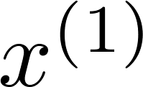
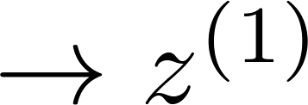
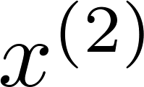
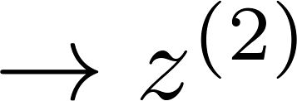
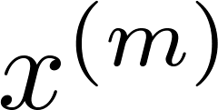
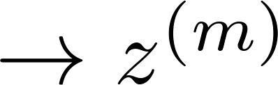

Data Compression
Reduce data from
2D to 1D
(inches)
(cm)
Notes:
Add more unique colors (3-4)

Slide 4
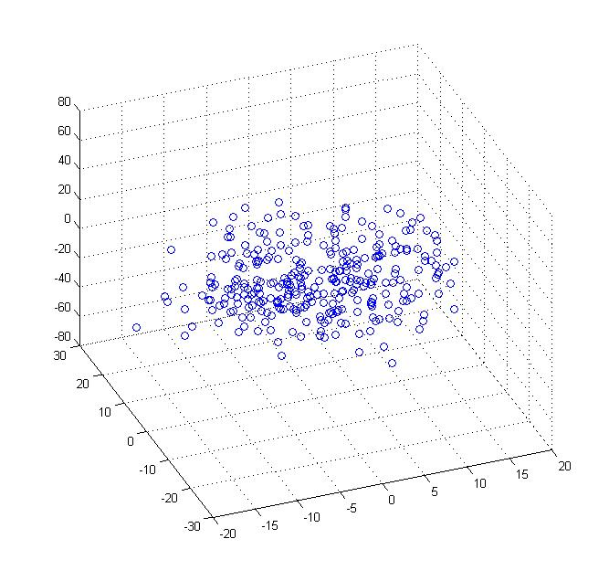
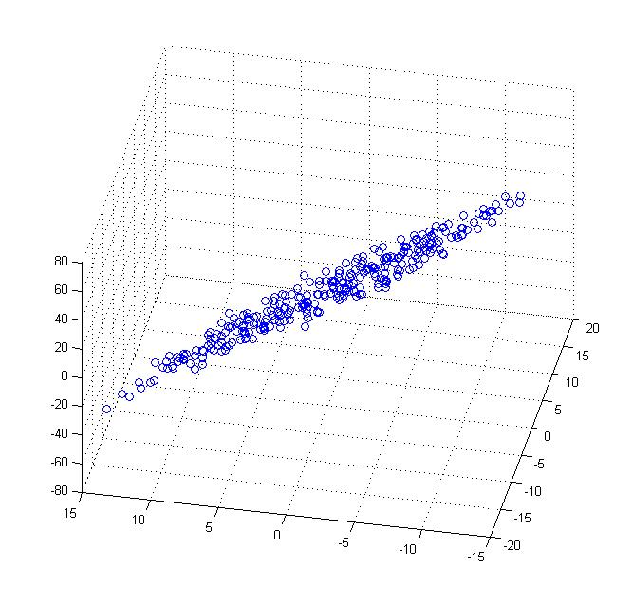
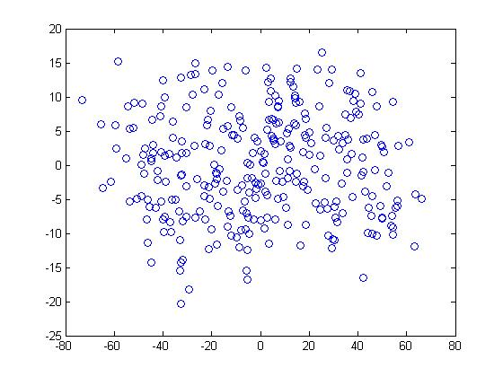


Data Compression
Reduce data from 3D to 2D
Notes:
Pca3d2d in lecture-slides/assets/pca/
Label axes

Slide 5
Motivation I: Data Visualization
Dimensionality Reduction

Slide 6
Data Visualization
Country | GDP (trillions of US$) | Per capita GDP (thousands of intl. $) | Human Develop-ment Index | Life expectancy | Poverty Index (Gini as percentage) | Mean household income (thousands of US$) | …
Canada | 1.577 | 39.17 | 0.908 | 80.7 | 32.6 | 67.293 | …
China | 5.878 | 7.54 | 0.687 | 73 | 46.9 | 10.22 | …
India | 1.632 | 3.41 | 0.547 | 64.7 | 36.8 | 0.735 | …
Russia | 1.48 | 19.84 | 0.755 | 65.5 | 39.9 | 0.72 | …
Singapore | 0.223 | 56.69 | 0.866 | 80 | 42.5 | 67.1 | …
USA | 14.527 | 46.86 | 0.91 | 78.3 | 40.8 | 84.3 | …
… | … | … | … | … | … | …
[resources from en.wikipedia.org]
Notes:
Add dots

Slide 8
Data Visualization
Country
Canada | 1.6 | 1.2
China | 1.7 | 0.3
India | 1.6 | 0.2
Russia | 1.4 | 0.5
Singapore | 0.5 | 1.7
USA | 2 | 1.5
… | … | …

Slide 9
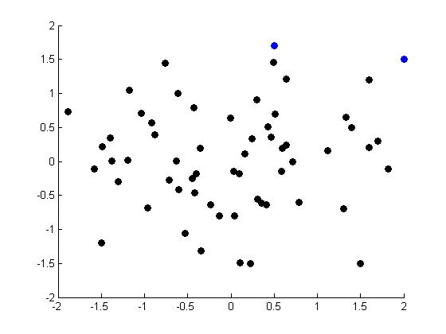
Data Visualization
Notes:
Make points look uncorrelated
US, Singapore in blue

Slide 10
Principal Component Analysis (Problem formulation)
Dimensionality Reduction

Slide 11
Principal Component Analysis (PCA) problem formulation
Notes:
Change numbers to LATEX as well

Slide 12

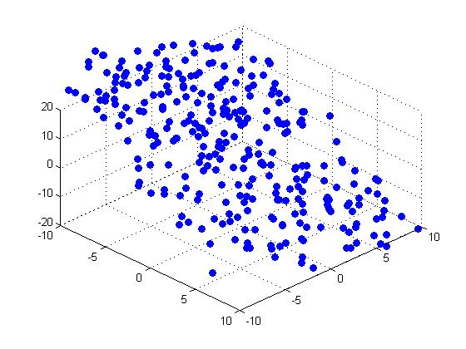


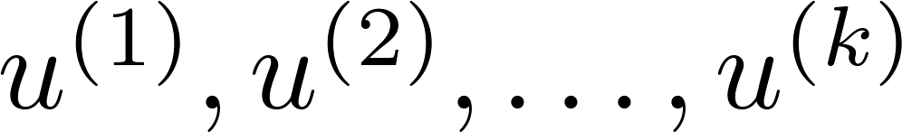
Principal Component Analysis (PCA) problem formulation
Reduce from 2-dimension to 1-dimension: Find a direction (a vector )
onto which to project the data so as to minimize the projection error.
Reduce from n-dimension to k-dimension: Find vectors
onto which to project the data, so as to minimize the projection error.
Notes:
Change numbers to LATEX as well

Slide 13
PCA is not linear regression
Notes:
Add animation to block left graph

Slide 14
PCA is not linear regression
Notes:
Add animation to block left graph

Slide 15
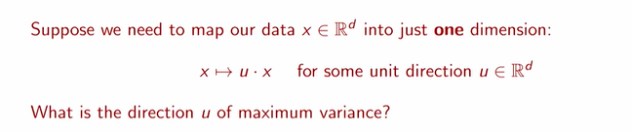
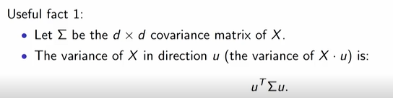
Direction of Maximum variance: The Best Direction

Slide 16
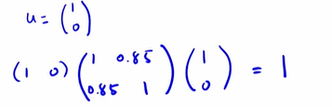
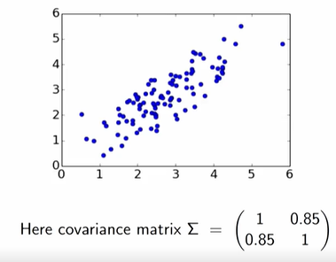
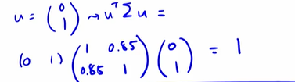
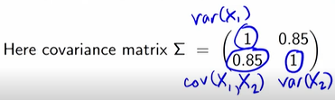
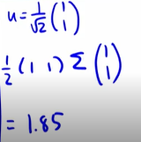


Best Direction Example

Slide 17
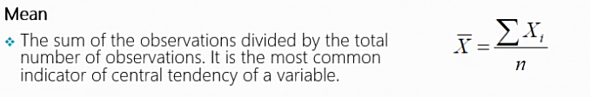
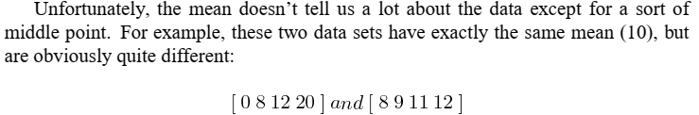
Covariance and other statistics concepts
Statistics: The entire subject of statistics is based around the idea that you have this big set of data, and you want to analyse that set in terms of the relationships between the individual points in that data set.

Slide 18
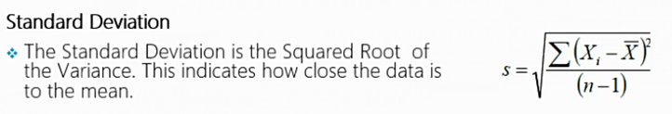
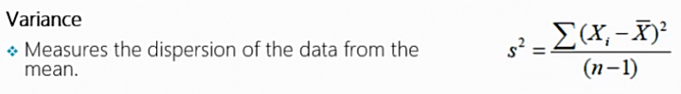

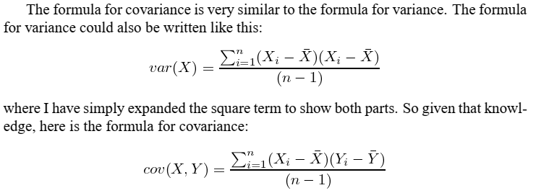
Covariance and other statistics concepts
Notes:
The last two measures we have looked at are purely 1-dimensional. Data sets like this could be: heights of all the people in the room, marks for the last COMP101 exam etc. However many data sets have more than one dimension, and the aim of the statistical analysis of these data sets is usually to see if there is any relationship between the dimensions. For example, we might have as our data set both the height of all the students in a class, and the mark they received for that paper. We could then perform statistical analysis to see if the height of a student has any effect on their mark. Standard deviation and variance only operate on 1 dimension, so that you could only calculate the standard deviation for each dimension of the data set independently of the other dimensions. However, it is useful to have a similar measure to find out how much the dimensions vary from the mean with respect to each other.

Slide 19
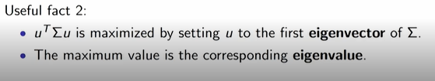
Direction of Maximum variance: The Best Direction

Slide 20
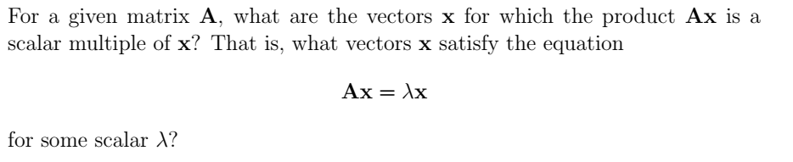
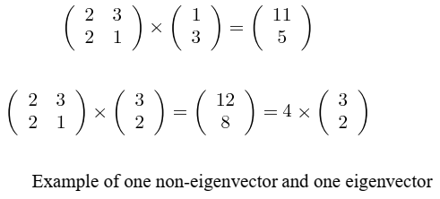
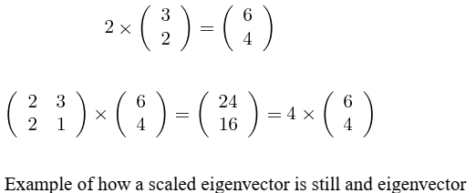
Eigen Vectors and Eigen Values
Ax = b

Slide 21
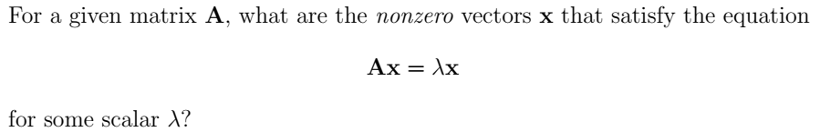
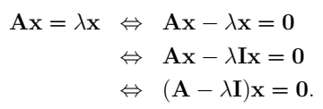

Eigen Vectors and Eigen Values

Slide 22

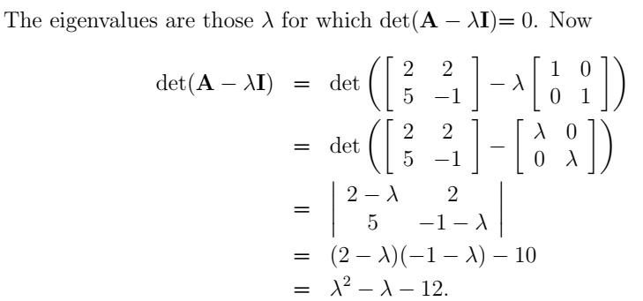
Eigen Vectors and Eigen Values

Slide 23
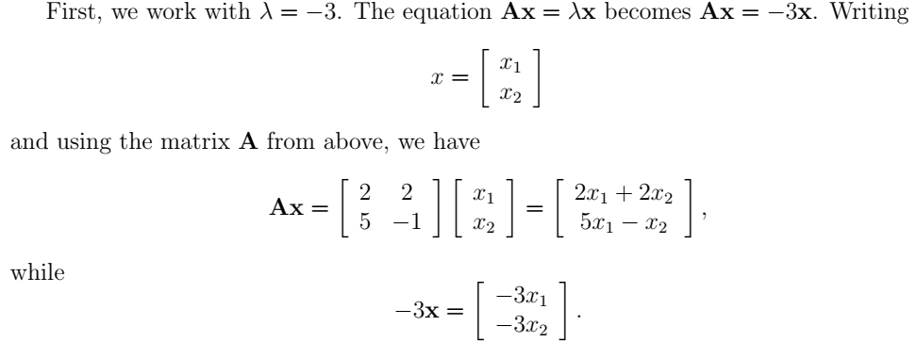
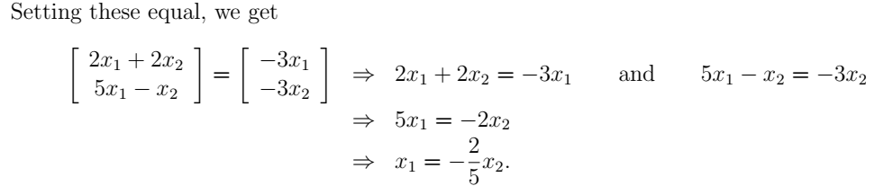
Eigen Vectors and Eigen Values

Slide 24
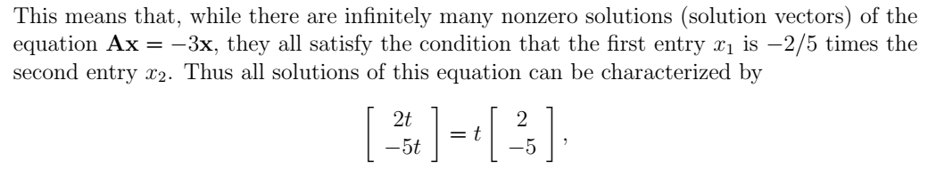
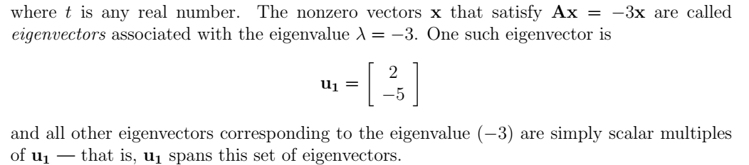
Eigen Vectors and Eigen Values

Slide 25
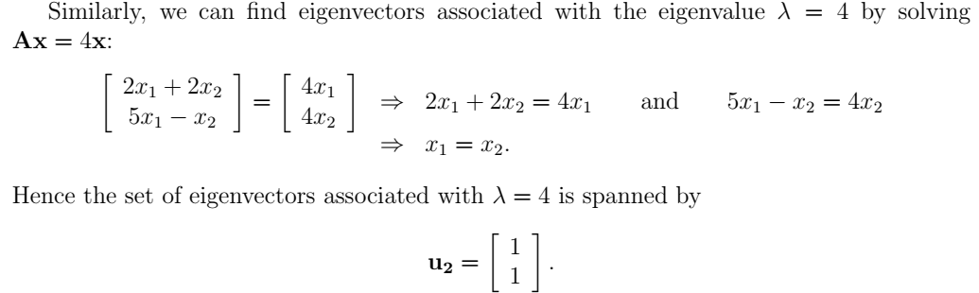
Eigen Vectors and Eigen Values

Slide 26
Principal Component Analysis Algorithm
Dimensionality Reduction

Slide 27
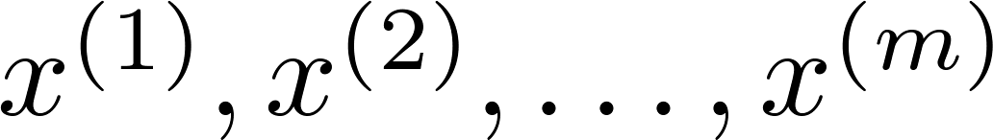
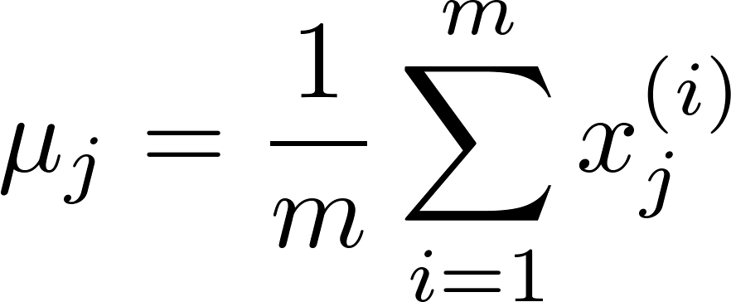
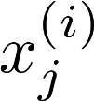



Data preprocessing
Training set:
Preprocessing (feature scaling/mean normalization):
Replace each with .
If different features on different scales (e.g., size of house,
number of bedrooms), scale features to have comparable range of values.
Notes:
Replace as previous; change spacing to fill page

Slide 28


Principal Component Analysis (PCA) algorithm
Reduce data from 2D to 1D
Reduce data from 3D to 2D
Notes:
Replace as previous; change spacing to fill page

Slide 29


Principal Component Analysis (PCA) algorithm
Reduce data from -dimensions to -dimensions
Compute “covariance matrix”:
Compute “eigenvectors” of matrix Sigma :
U, s, V = np.linalg.svd(Sigma)
Sigma $=\frac{1}{m}(X^{T}.X)$ , where X is mxn data matrix

Slide 30
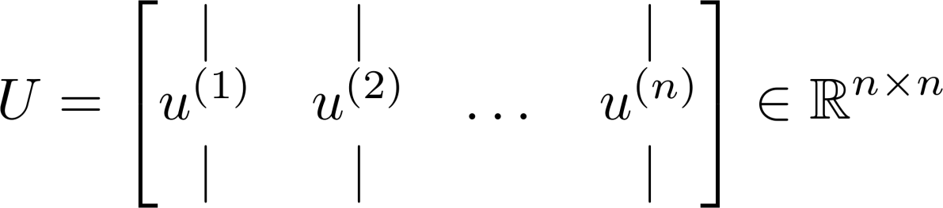
Principal Component Analysis (PCA) algorithm
From , we get:
U, s, V = np.linalg.svd(Sigma)

Slide 31
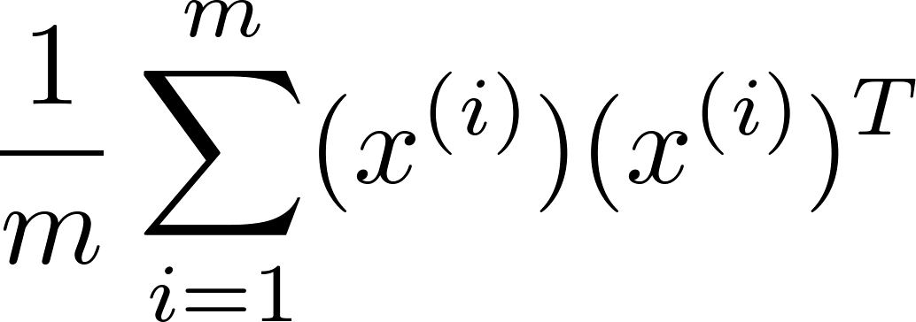
Principal Component Analysis (PCA) algorithm summary
After mean normalization and optionally feature scaling:
Sigma =
U, s, V = np.linalg.svd(Sigma)
Ureduce = U(:,1:k);
z = (Ureduce)^{T} * x;

Slide 32
Reconstruction from compressed representation
Dimensionality Reduction

Slide 33
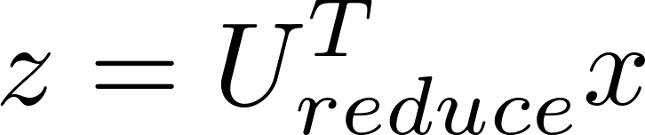
Reconstruction from compressed representation
Notes:
Make points have 0 mean on x1 and x2

Slide 34
Choosing the number of Principal Components
Dimensionality Reduction

Slide 35
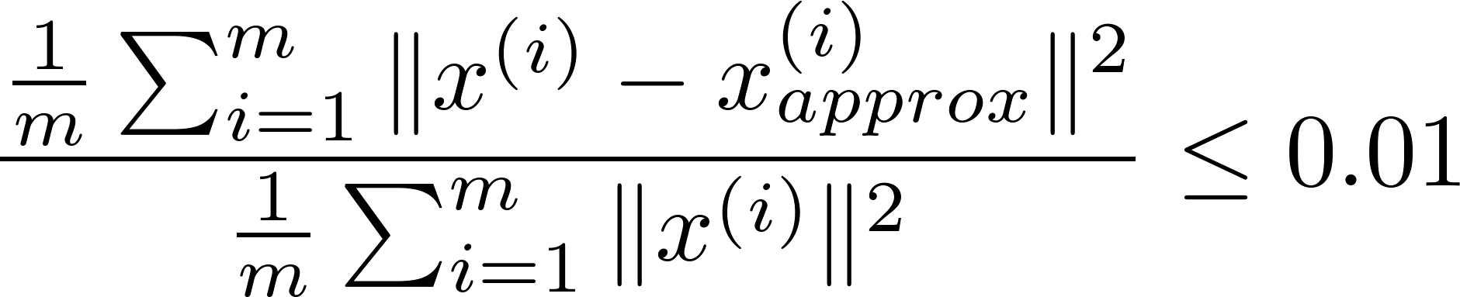
Choosing (number of principal components)
Average squared projection error:
Total variation in the data:
Typically, choose to be smallest value so that
“99% of variance is retained”
(1%)

Slide 36



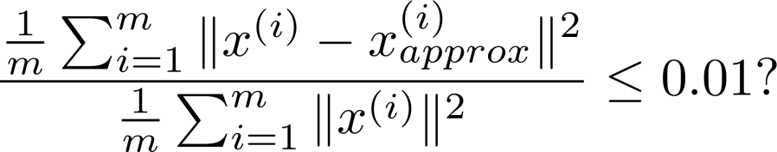
Choosing (number of principal components)
Algorithm:
Try PCA with
Compute
Check if
[U,S,V] = svd(Sigma)

Slide 37
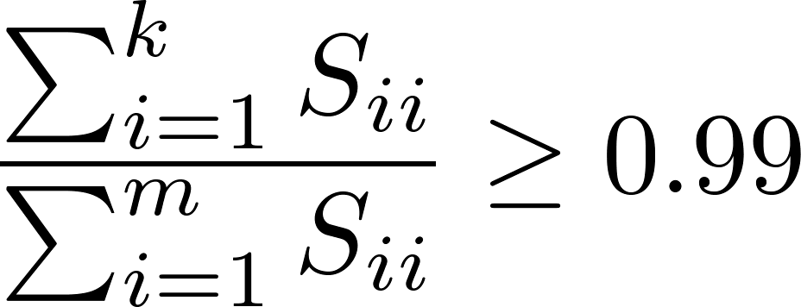
Choosing (number of principal components)
[U,S,V] = svd(Sigma)
Pick smallest value of for which
(99% of variance retained)

Slide 38
Advice for Applying PCA
Dimensionality Reduction

Slide 39

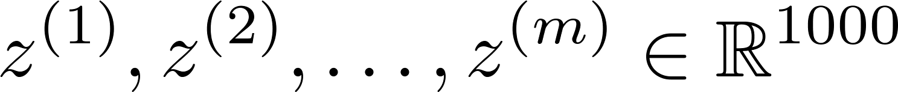
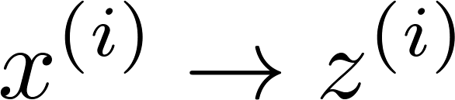

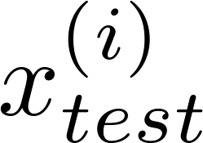
Supervised learning speedup
Extract inputs:
Unlabeled dataset:
New training set:
Note: Mapping should be defined by running PCA only on the training set. This mapping can be applied as well to the examples and in the cross validation and test sets.

Slide 40
Application of PCA
Compression
Reduce memory/disk needed to store data
Speed up learning algorithm
Visualization

Slide 41
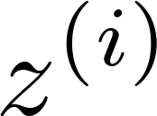


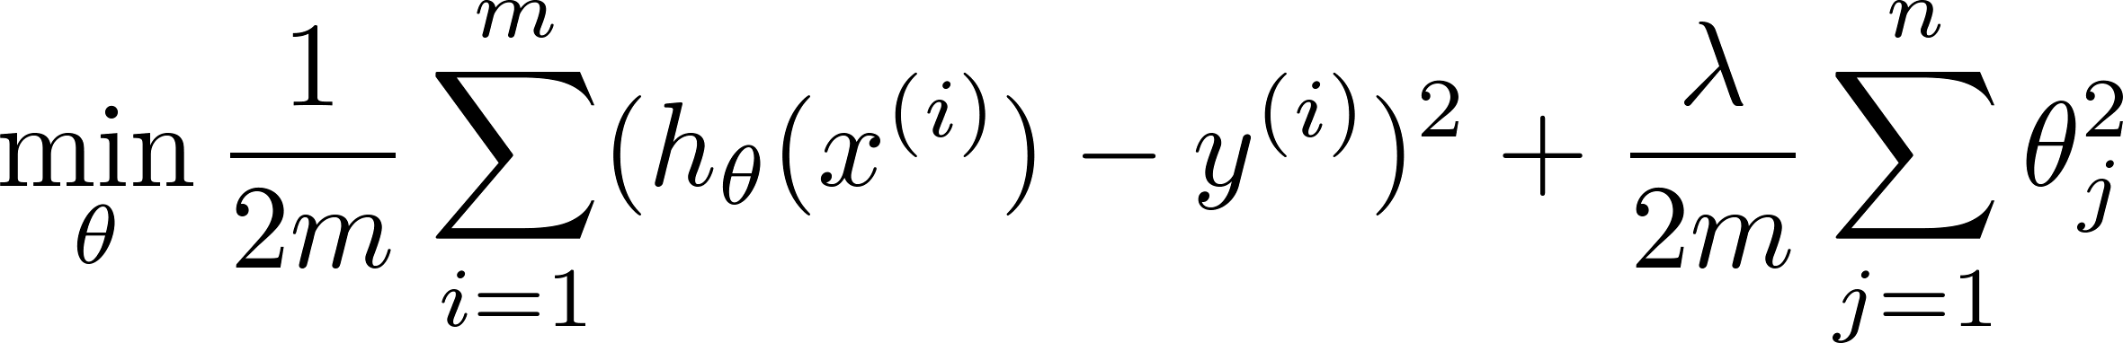
Bad use of PCA: To prevent overfitting
Use instead of to reduce the number of features to
Thus, fewer features, less likely to overfit.
This might work OK, but isn’t a good way to address overfitting. Use regularization instead.

Slide 42






PCA is sometimes used where it shouldn’t be
Design of ML system:
Get training set
Run PCA to reduce in dimension to get
Train logistic regression on
Test on test set: Map to . Run on
How about doing the whole thing without using PCA?
Before implementing PCA, first try running whatever you want to do with the original/raw data . Only if that doesn’t do what you want, then implement PCA and consider using .

